Slide 1


JAVA PROJECT WORKSHOP
(JDBC – Part 3)
Lecture 3

Slide 2
Executing Non Select Queries
In JDBC to execute non select queries we use the method executeUpdate( ) provided by the Statement interface.
The prototype of the method is :
public int executeUpdate(String sql) throws SQLException

Slide 3
Executing Non Select Queries
This method takes any non-select sql command as argument and returns the number of rows effected by that command.
There are 3 possible cases with return value:
1. >0 which means that atleast one row has been effected
2. =0 which means none of the rows have been effected
3. =-1 which means that the query is DDL ( but this case is driver dependent)

Slide 4
Inserting New Record
So to insert a new record using executeUpdate( ) method our code will be:
Example:
Statement st=conn.createStatement();
String qry=“Insert into employees values(100, ‘Vishal’,4500)";
int res=st.executeUpdate(qry);
System.out.println("Record inserted:"+res);

Slide 5
Removing A Record
Similarly to remove a record of the employee with name Amit from the employees table the code will be:
Example:
Statement st=conn.createStatement();
String qry=“Delete from employees where ename=‘Amit’;
int res=st.executeUpdate(qry);
System.out.println("Record deleted:"+res);

Slide 6
Updating A Record
Just like insert and delete , we can also execute update command using the method executeUpdate( ) .
So for updating sal of the employee with empno 101 by increasing 1000 rupees in the employees table , the code will be:
Example:
Statement st=conn.createStatement();
String qry=“Update employees set sal=sal+1000 where empno=101’;
int res=st.executeUpdate(qry);
System.out.println("Record updated:"+res);

Slide 7
Dynamic SQL
The term dynamic SQL means an SQL query which contains dynamic values , i.e, the values are supplied at run time
For example , we want to insert records in the database by accepting values from the user.

Slide 8
Dynamic SQL
To solve this problem we have 2 options:
1. Use Statement object and create a dynamic sql query by using STRING CONCATENATION
2. Use PreparedStaement

Slide 9
Using String Concatenation
String qry= “insert into employees values(”+id+ “,’ ” +ename + “ ‘ ,”+ income+ “ )” ;
The query above has been designed assuming that we have a table called employees containing three columns for empno,ename and sal .
The variables id , ename and income are java variables holding user input

Slide 10
Drawbacks Of String Concatenation
It is very difficult to write as we have manually insert single quotes
It is a programmer’s responsibility to handle date conversions
It is prone to a very famous sql attack called SQL INJECTION

Slide 11
PreparedStatement
The PreparedStatement interface extends the Statement interface which gives us added functionality with a couple of advantages over a generic Statement object.
This statement gives us the flexibility of supplying arguments dynamically.

Slide 12
PreparedStatement
PreparedStatement object is created using prepareStatement ( ) in Connection interface.
PreparedStatement pst = null;
String SQL = “Insert into employees values(? ,? ,?)”;
pst = conn.prepareStatement(SQL);
All parameters in JDBC are represented by the ? symbol, which is known as the placeholder
We must supply values for every placeholder before executing the SQL statement.

Slide 13
setXXX( ) methods
The setXXX( ) methods bind values to the parameters, where XXX represents the Java data type of the value you wish to bind to the input parameter. If you forget to supply the values, you will receive a SQLException.
setXXX( ) method takes two arguments representing position of placeholder (?) and value to replace respectively.
Each placeholder is referred to by its ordinal position.
The first placeholder represents position 1, the next position 2, and so forth.
pst.setInt(1, 101);
pst.setString(2,”Ravi”);
pst.setDouble(3,500.0);

Slide 14
Statement V/s PreparedStatement
Statement | PreparedStatement
It is used to execute normal SQL queries. | It is used to execute parameterized or dynamic SQL queries.
It is preferred when a particular SQL query is to be executed only once. | It is preferred when a particular query is to be executed multiple times.
You cannot pass the parameters to SQL query using this interface. | You can pass the parameters to SQL query at run time using this interface.
This interface is mainly used for DDL statements like CREATE, ALTER, DROP etc. | It is used for any kind of SQL queries which are to be executed multiple times.
The performance of this interface is very low. | The performance of this interface is better than the Statement interface (when used for multiple execution of same query).

Slide 15
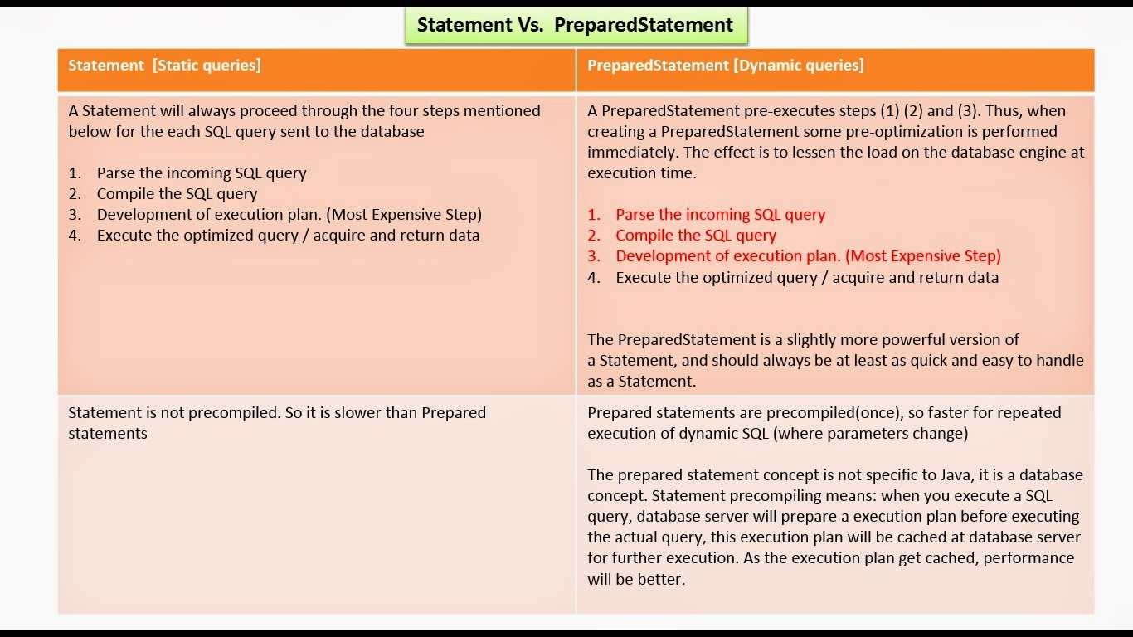
Statement V/s PreparedStatement

